Slide 1
UIDAI Hackathon
Team Reference ID : mHN1pfWNYU
Team Member Details
Sl No | Name | E Mail ID
1 | AJAI BHALAJI S | 19eucs005@skcet.ac.in
2 | BINESH J | 19eucs024@skcet.ac.in
3 | JAYANTH C R | 19eucs049@skcet.ac.in
4 | JEBA REGAN RAJ B | jebaregan20@gmail.com

Slide 2
About the Problem Statement
Theme : Address Update
Problem Statement:
Address Update Challenge in Urban Areas:
Imagine you have been selected through Campus recruitment by the UIDAI to join its Technology Centre at Bangalore to work on cutting-edge opensource technologies. Having moved to Bangalore, you landed up in a situation, wherein you need to provide your updated Aadhaar to apply for a Broadband connection. You do not have any supporting documentation to prove your current address. As per the current policy, Aadhaar requires a supporting Proof of Address (PoA) document or an Introducer who can lend his address to update the aadhaar.

Slide 3
Approach
For updating address in aadhaar,
The user has to provide donor’s aadhaar credentials(phone number or aadhaar number) to send request.
The donor can view user’s request and either accept or rejects the request.
If the donor rejects the request , the user will be redirected to the home page , else he can proceed through further steps.
The address of the donor will be shared with the user and he can undertake minor edit to the address.
The modified address will be verified with the current location of the user through GPS. If it matches, address of the user will be updated , else he will be asked to enter appropriate address.

Slide 4
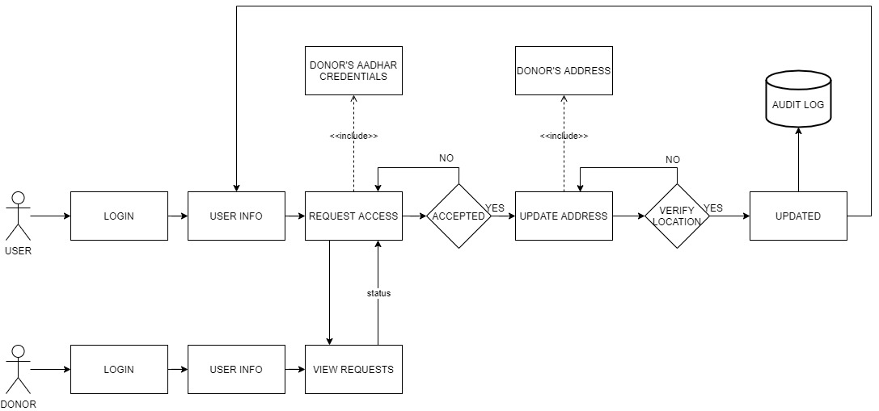
Architectural Diagram

Slide 5
API Usage
OTP API:
OTP Request API is used to generate OTP for resident whose mobile number is registered with his/her Aadhaar number. The generated OTP will be subsequently used for authentication.
Aadhaar EKYC API:
Aadhaar E-KYC API is used to fetch the E-KYC details of a resident.

Slide 6
Security Considerations
While requesting access from donor , the user can’t able to view the address of the donor until the donor accepts his/her request.
In audit log, we store only user and donor’s phone number and address.
We won’t share or store user’s aadhaar number anywhere.

